Slide 1

Design and Development a Travel Guide Web Application
Supervised By
Dr. Md Mostafijur Rahman Associate Professor
Department of Software Engineering
Daffodil International University
Persented By
Anamika Das
ID : 161-35-1440

Slide 2

Outline
Background
Reference
10
Proposed
Solution
1
Conclusion
9
2
Result & Discussion
Objective
8
3
Outlines
Comparison
System Implementation
7
4
5
6
System Design
Tools & Technology
1

Slide 3
Background
When to Hire a Travel Guide :
When you have very little time.
To hand off the logistics of travel.
On hikes or cruises excursion.
When visiting dangerous or chaotic locations.
When visiting extremely popular or historic destinations.
On an adventure trip.
When language barriers are high.
2

Slide 4
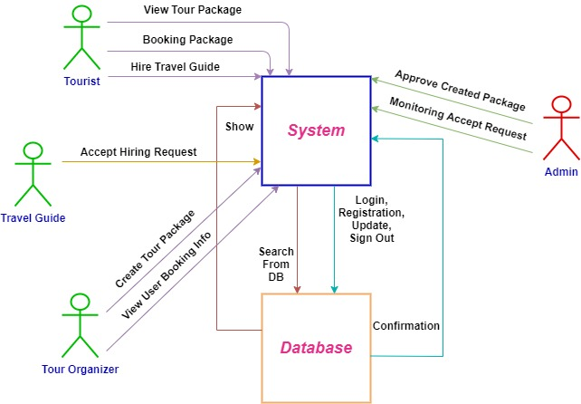
Proposed Solution
Since people are now dependent on mobile and websites, I have chosen website development to solve this problem.
Figure: Proposed System
3

Slide 5
Objective or Goal
Travelers will get a helping hand.
People will find jobs as travel guides.
Event organizers will get travelers for their tour package.
A start-up company can be launched from this platform.
4

Slide 6
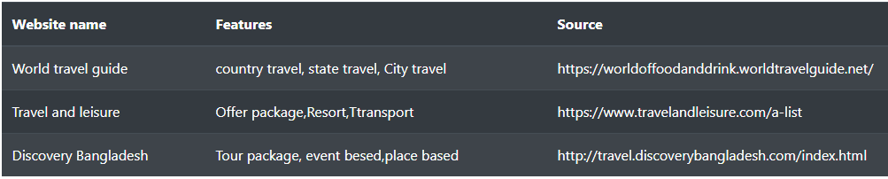
Comparison with Existing Technology
5

Slide 7
System Outline and Design
The design of web system is divided into six categories.
Use case diagram
Activity diagram
Sequence diagram
Class diagram
ER diagram
User Manual
6

Slide 8
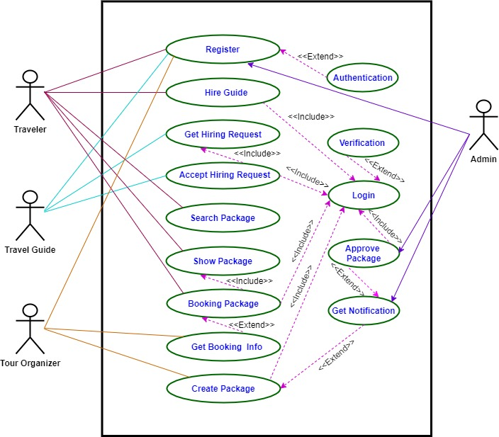
Use Case Diagram
Figure: Use Case Diagram
7

Slide 9
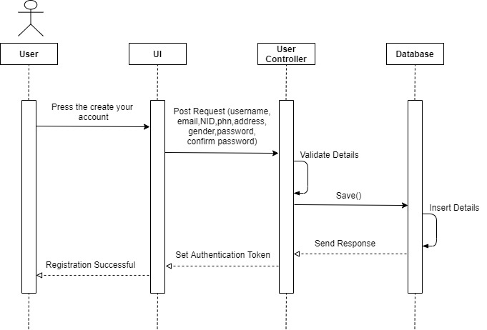
Sequence Diagram
Figure: Registration of Sequence Diagram
8

Slide 10
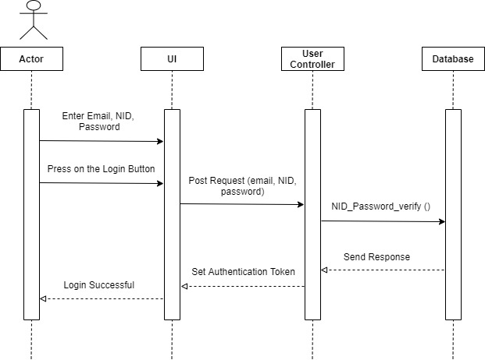
Sequence Diagram
Figure: Login of Sequence Diagram
9

Slide 11
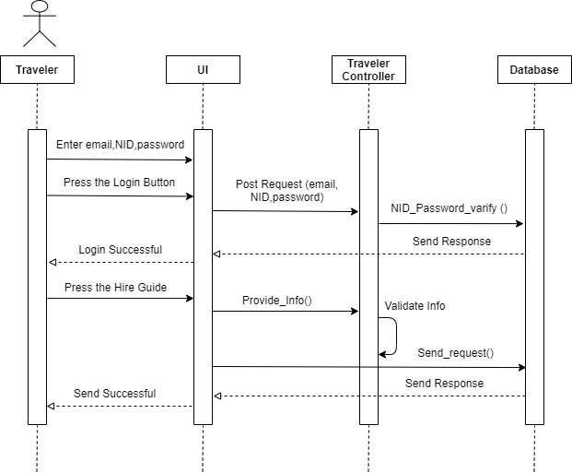
Sequence Diagram
Figure: Hire Travel Guide
10

Slide 12
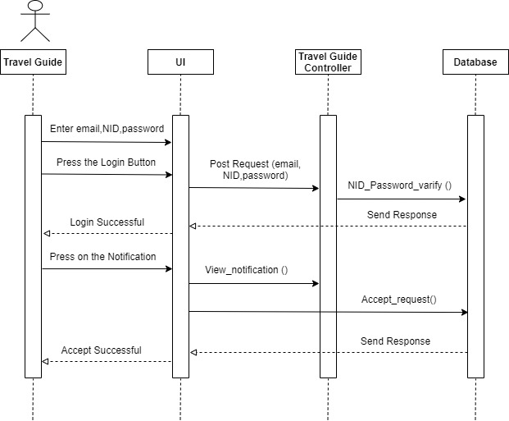
Sequence Diagram
Figure: Get and Accept Hiring Request
11

Slide 13
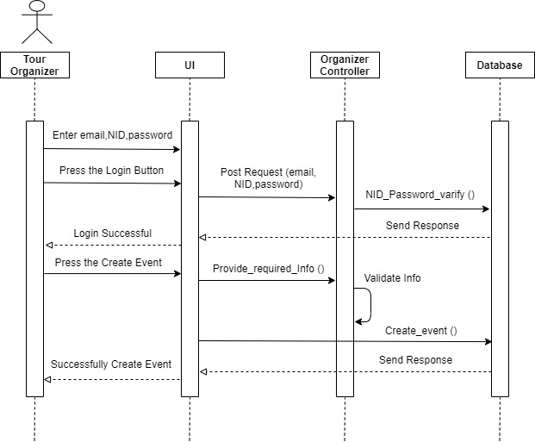
Sequence Diagram
Figure: Create Tour Package
12

Slide 14
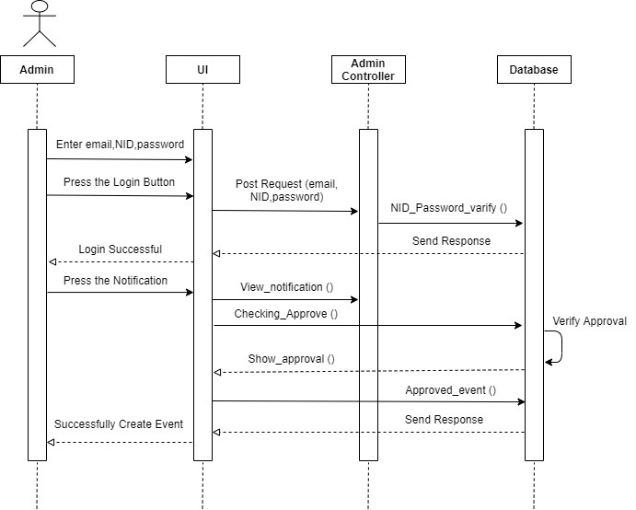
Sequence Diagram
Figure: Approve Created Package
13

Slide 15
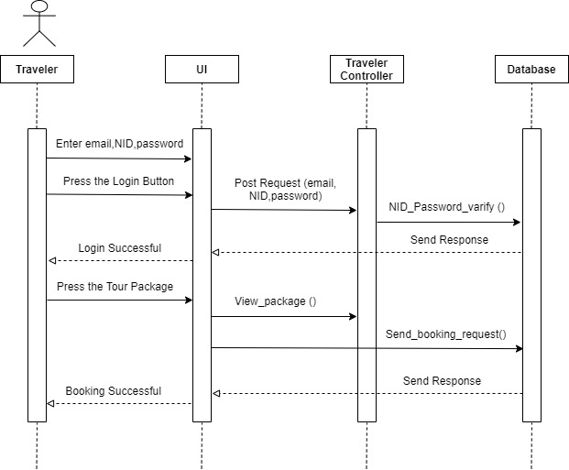
Sequence Diagram
Figure: Booking Tour Package
14

Slide 16
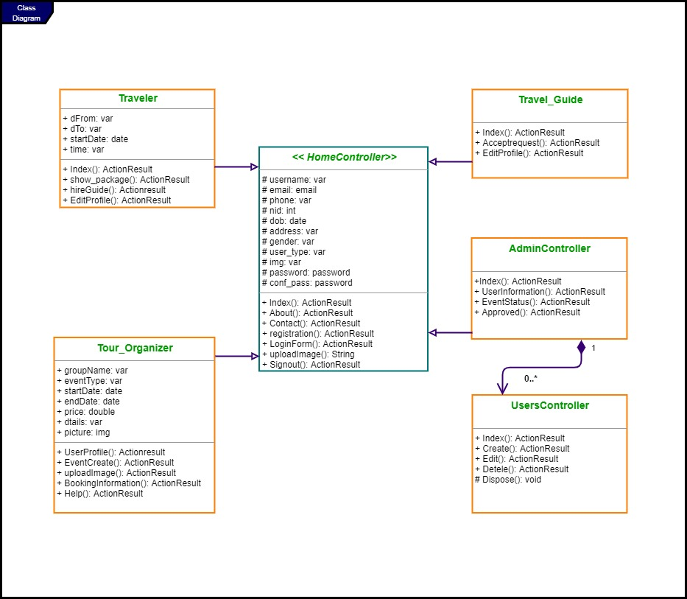
Class Diagram
Figure: Class Diagram
15

Slide 17
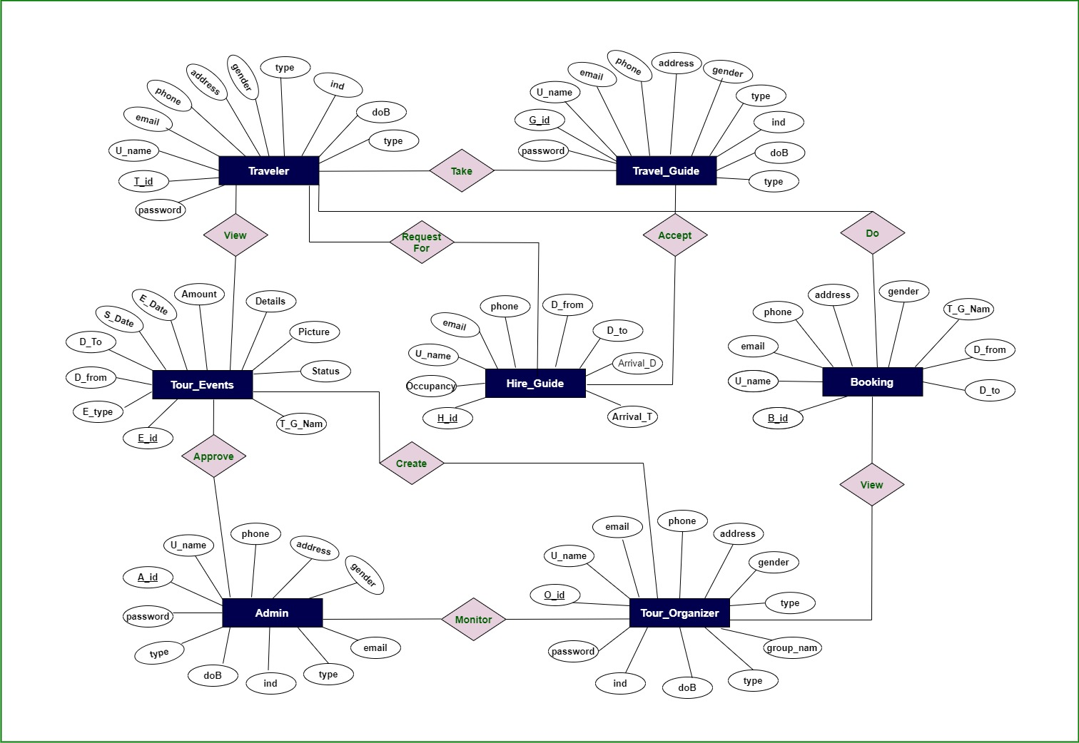
Database Architecture Diagram
Figure: Entity Relationship Diagram
16

Slide 18
Tools and Technology
Technology :
Programming language: C#
Framework: ASP.NET MVC
Design: html, CSS, bootstrap, JavaScript, JQuery
Web server: IIS Express
Tools :
Microsoft Visual Studio
Sublime Text 3
SQL Server Management Studio
17

Slide 19
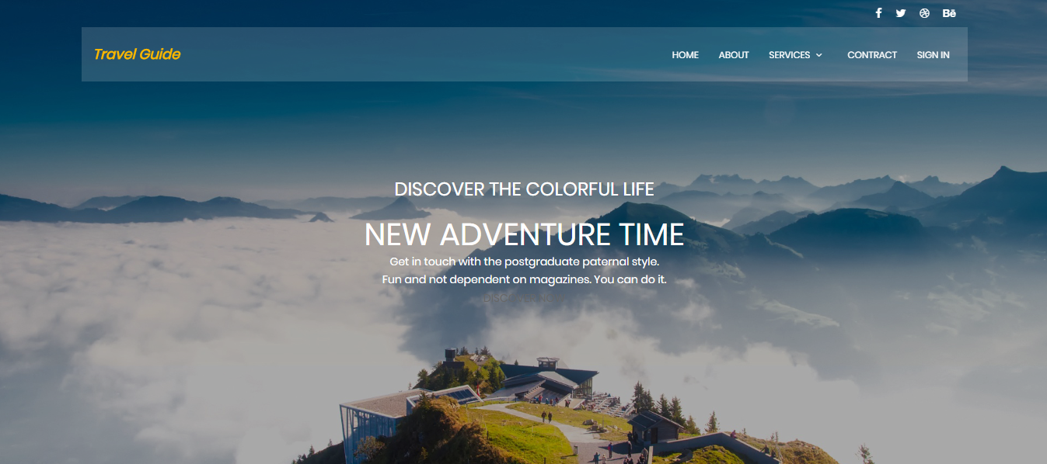
System Implementation
User Manual : Home
18

Slide 20
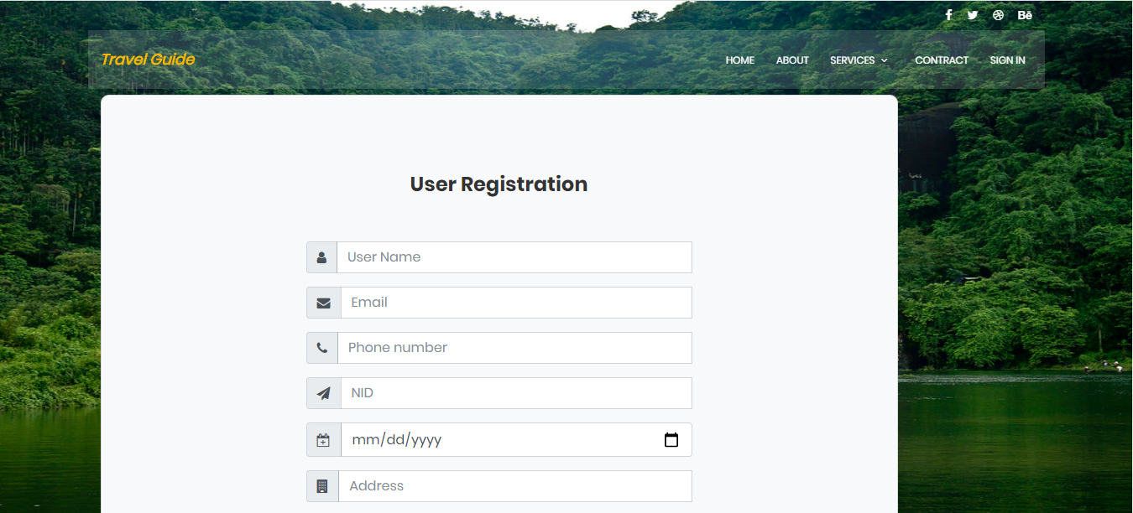
System Implementation
Registration
19

Slide 21
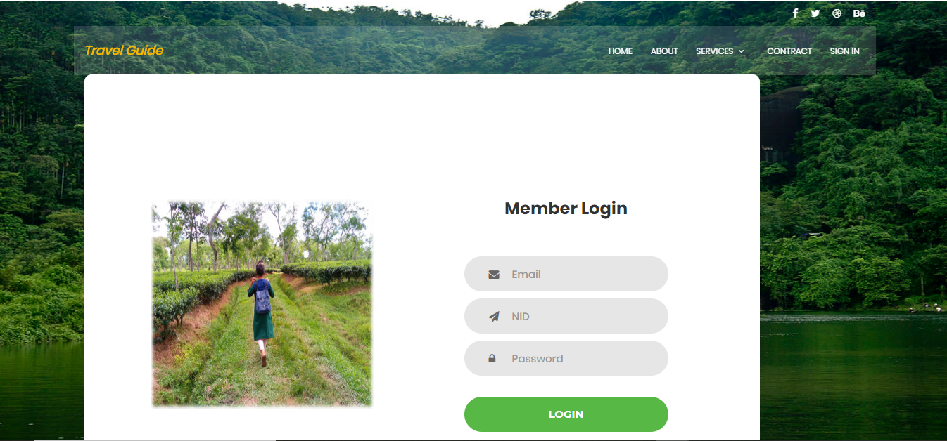
System Implementation
Login
20

Slide 22
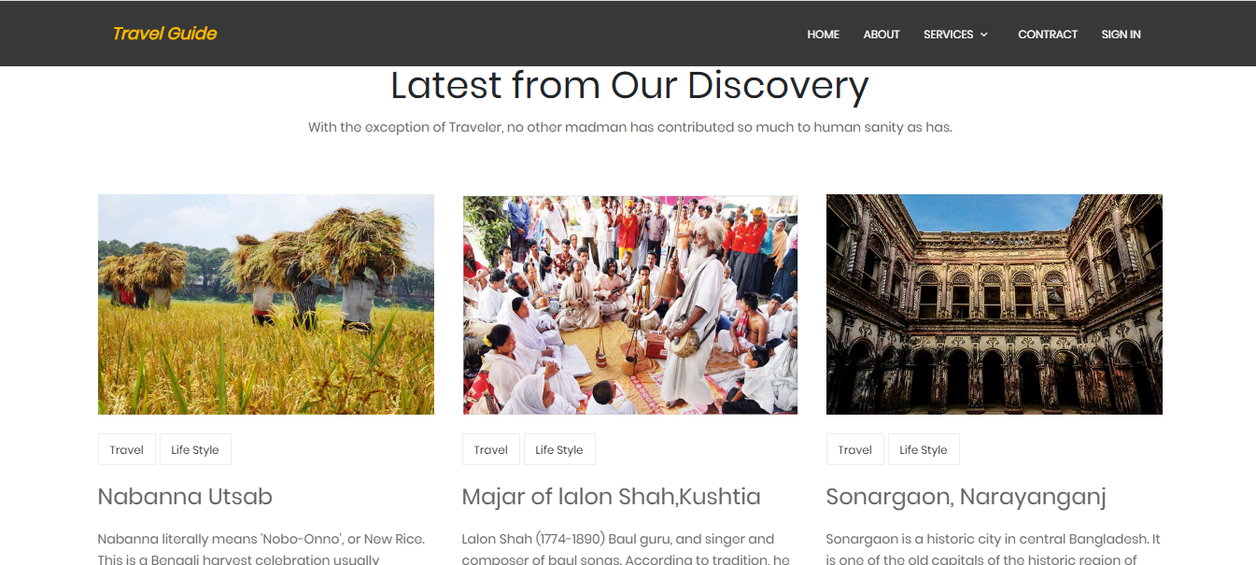
System Implementation
About
21

Slide 23
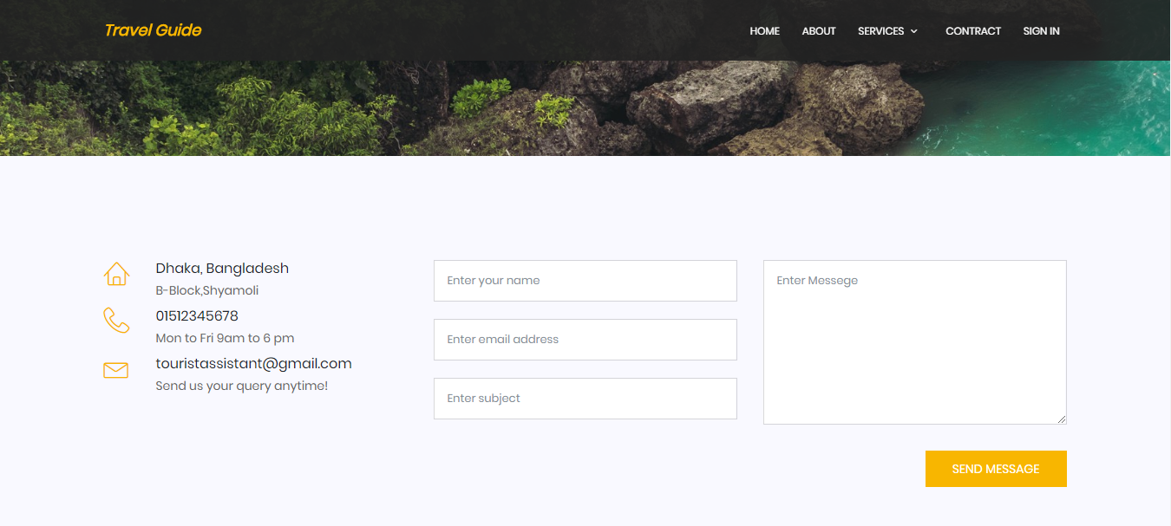
System Implementation
Contract
22

Slide 24
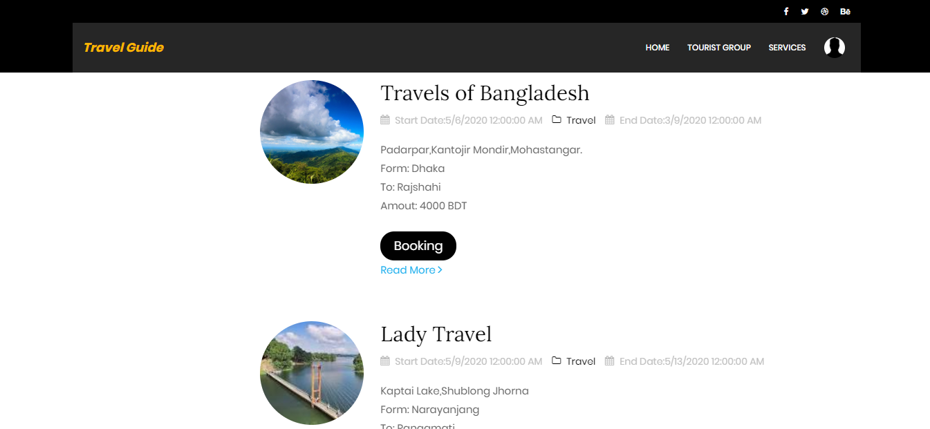
System Implementation
Booking of Traveler
23

Slide 25
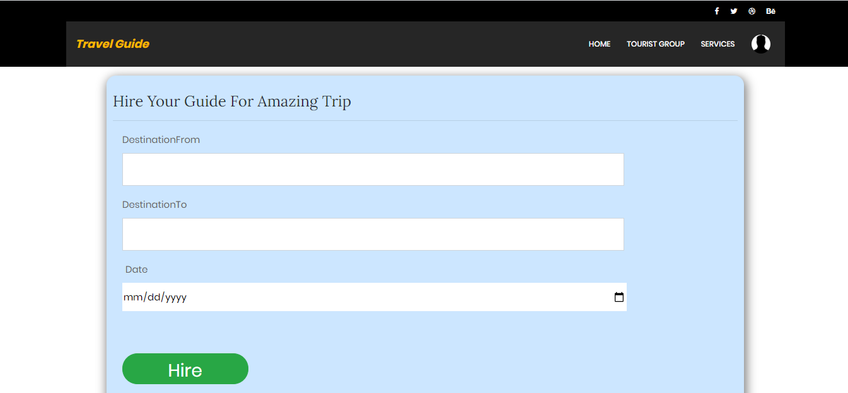
System Implementation
Hire Guide
24

Slide 26
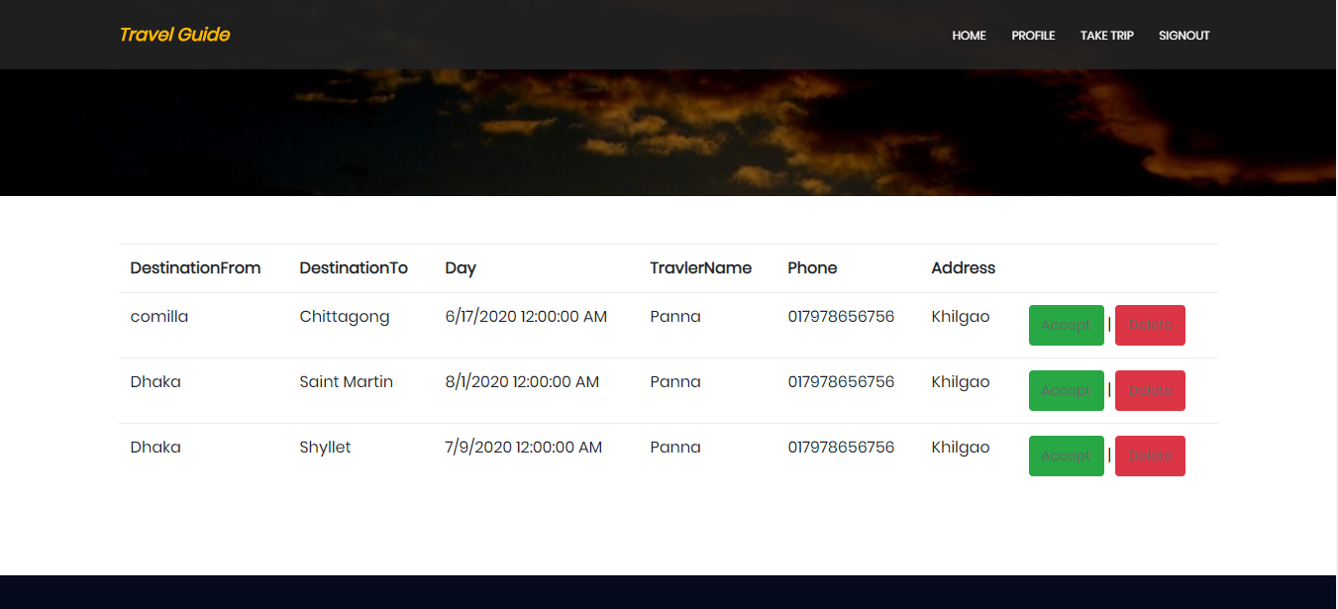
System Implementation
Take Trip
25

Slide 27
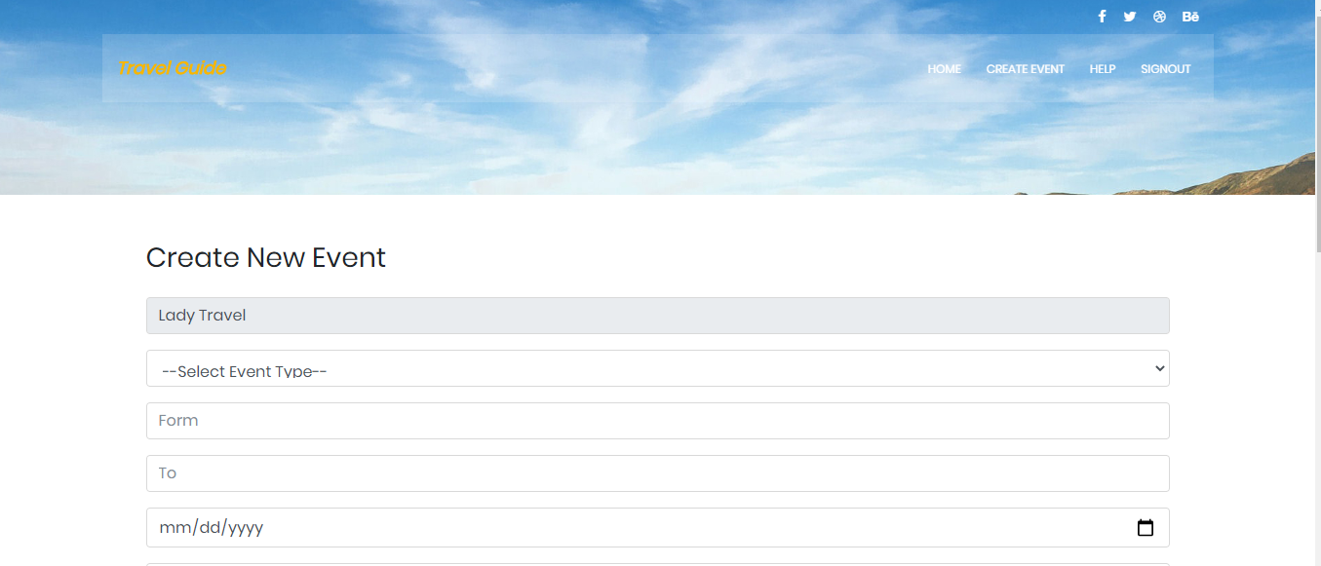
System Implementation
Tour Event Create by Organizer
26

Slide 28
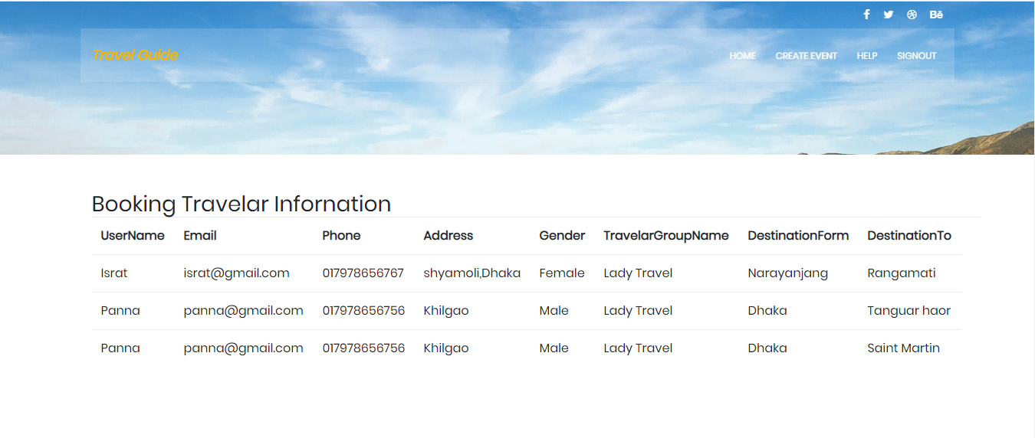
System Implementation
Show Booking Info by Organizer
27

Slide 29
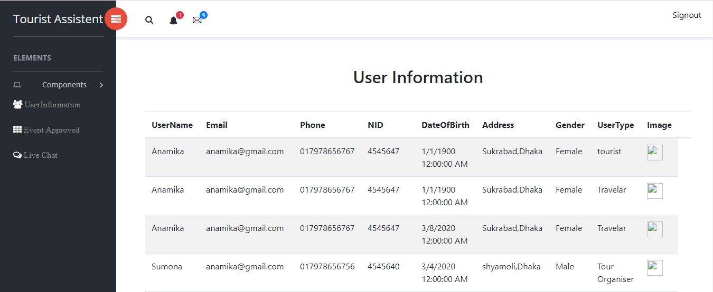
System Implementation
Check User Info by Admin
28

Slide 30
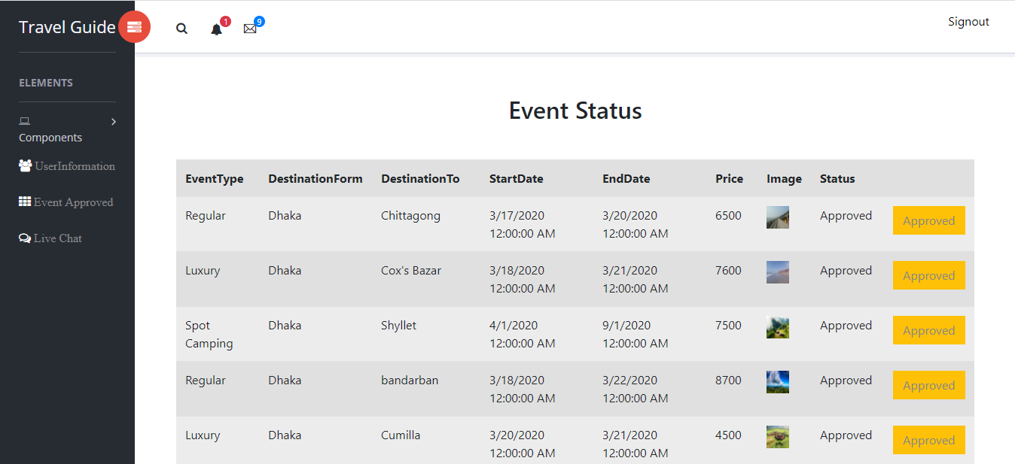
System Implementation
Created Tour Event Approved
29

Slide 31
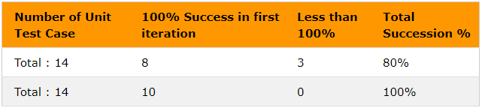
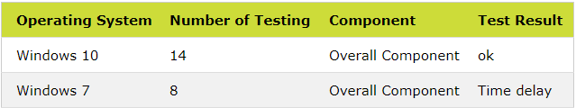
Result and Discussion
Testing :
Black Box Testing(By Test Case)
Bug Test
30

Slide 32
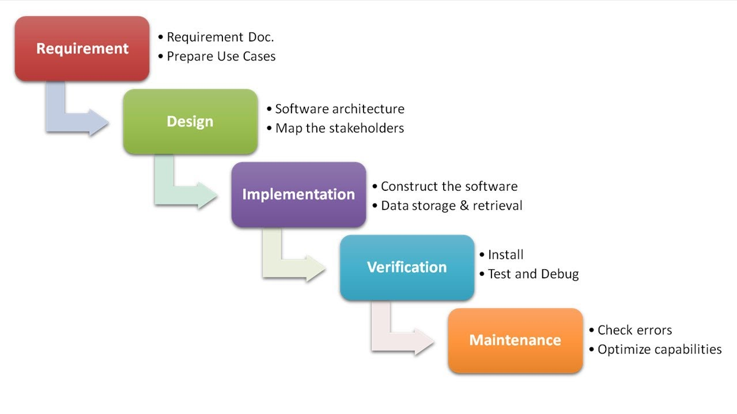
Conclusion and Overview
31

Slide 33
Future work
Email Transformation system
NID Scan, call on the Phone
Payment Gateway
Launch Start-up Platform
32

Slide 34
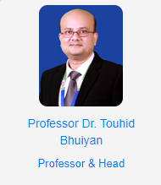
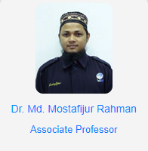

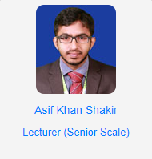
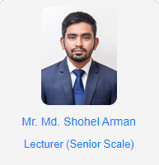
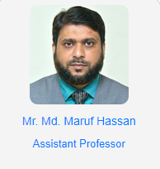
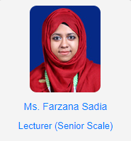
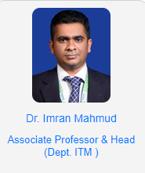
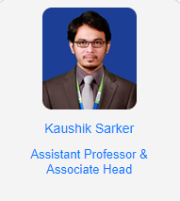
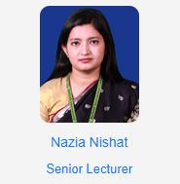
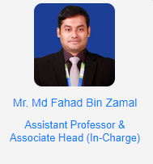

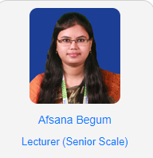
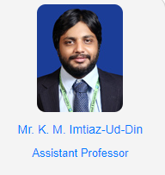
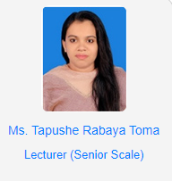
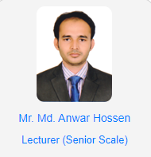
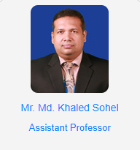
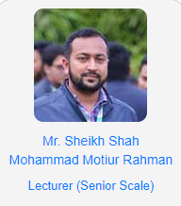
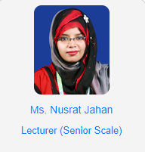
Acknowledgement
33

Slide 35
References
[1] About HTML & CSS methodology, available at <
https://www.w3schools.com>
; last accessed on 17.08.2019, Time: 6:15pm
[2] About JavaScript methodology, available at <
https://www.javascriptmancy.com
>; last accessed on 25.08.2019, Time: 8:15pm
[3] Template Choose, available at<
https://colorlib.com/wp/templates/
>; last accessed on 06.09.2019, Time: 9:30pm
[4] About Bootstrap methodology, available at <
https://getbootstrap.com
>; last accessed on 25.09.2019, Time: 8:15pm
34

Slide 36
References
[5] About database management, Available at<
https://www.sqlshack.com/overview-of-microsoft-sql-server-managementstudio-ssms/
/>; last accessed on 29.10.2019; Time: 1.00am
[6] About c#, available at<
https://www.w3schools.com/cs/>
; last accessed on 06.11.2019; Time: 8.00pm
[7] About ASP.NET MVC Framework, available at< https://www.tutorialspoint.com/mvc_framework/mvc_framework_architecture.htm>
; last access on 05.12.2019; Time: 5.00 pm
[8] Learn about Sequence Diagram, available at<
https://www.geeksforgeeks.org/unified-modeling-language-uml-sequence-diagrams/
>; last access on 05.01.2020, Time: 9:40pm
35

Slide 37


